Slide 1
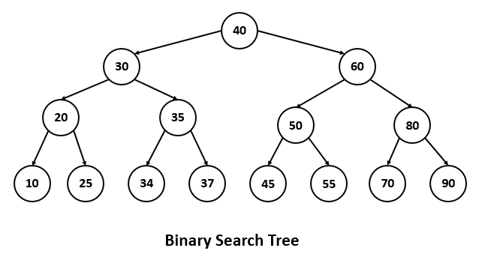
The height of a BST is given as h. Consider the height of the tree as the no. of edges in the longest path from root to the leaf. The maximum no. of nodes possible in the tree is?
a) 2^{h-1 -1}
b) 2^{h+1} -1
c) 2^{h +1}
d) 2^{h-1 +1}
Answer: b
Explanation:
Height = 3
2⁴ -1=16-1=15

Slide 2
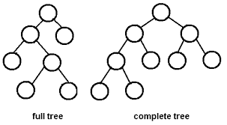
Suppose a binary tree is constructed with n nodes, such that each node has exactly either zero or two children. The maximum height of the tree will be?
a) (n+1)/2
b) (n-1)/2
c) n/2 -1
d) (n+1)/2 -1
Answer: b
Lets assume n=7
(7-1)/2=3

Slide 3
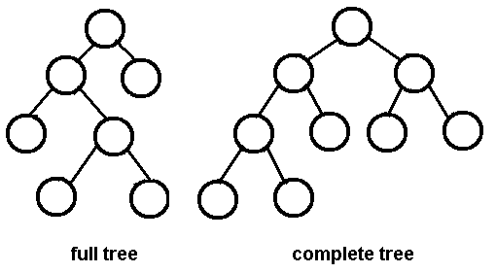
A full/strictly binary tree is a tree in which every node other than the leaves has two children.
A complete binary tree is a binary tree in which every level, except possibly the last, is completely filled, and all nodes are as far left as possible.

Slide 4
Suppose a complete binary tree has height h>0. The minimum no of leaf nodes possible in term of h is?
a) 2^{h} -1
b) 2^{h -1} + 1
c) 2^{h -1}
d) 2^{h} +1
Answer: b
Explaination:
2^2+1=4+1=5

Slide 5
A binary tree T has n leaf nodes. The number of nodes of degree 2 in T is
a) log2n
b) n-1
c) n
d) 2n
Answer: b
Explaination:
5-1=4

Slide 6
A binary search tree is generated by inserting in order the following integers:
50, 15, 62, 5, 20, 58, 91, 3, 8, 37, 60, 24
The number of the node in the left sub-tree and right sub-tree of the root, respectively, is
a) (4, 7)
b) (7, 4)
c) (8, 3)
d) (3, 8)
Answer: b

Slide 7
A full binary tree with n leaves contains
A. n nodes
B. log2n nodes
C. 2n - 1 nodes
D. 2n+1 nodes
Answer: C
Total Leaf Nodes are 4
2*4 -1 = 7

Slide 8
Consider an undirected graph G with 100 nodes. The maximum number of edges to be included in G so that the graph is not connected is
a. 2451
b. 4950
c. 4851
d. 9900
Answer: c
If a graph with n vertices has more than ((n - 1)*(n - 2))/2 edges then it is connected.
(100-1)*(100-2)/2
99 * 98/2
99 * 49 = 4851

